Slide 1
SG Technologies
Elaboration Phase
Nicholas Gennuso
Rafael de Oliveira
Jianing He
Jeremy Ying
Chang Sun
Matt Raporte
Keith Bell

Slide 2
Summary of current status
SG Technologies has completed the Inception and Elaboration parts of our POS System. During the Inception phase we planned the project and prepared a vision statement, use cases, supplementary specifications, a glossary and business rules. During the Elaboration phase we prepared a Software Architecture Document in which we translated the previous use cases into use case view diagrams (sequence diagrams), created data view diagrams (activity diagrams) and included package and class diagrams to demonstrate how everything will fit together. Finally, we got our hands dirty and built a working prototype of the “sale” use case using Java and Git for version control, including robust exception handling.
Throughout the project we’ve been staying organized by maintaining a Work Breakdown Structure (WBS) and a Responsibility Matrix (RM), attending weekly face-to-face scrum meetings and communicating electronically. We frequently evaluate both our group progress and individual contributions and make adjustments in order to maintain a high level of efficiency.
Going forward we will be moving into the Construction phase of the software development cycle. During Construction we will apply the design patterns we learned in class and build our working prototype into an alpha release version, we will then extensively test and document it.

Slide 3
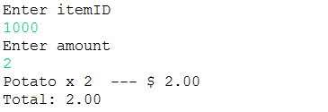
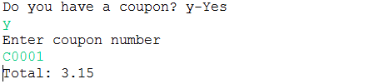

Demo
Cashier enters items presented by the Customer.
Cashier enters coupon presented by the Customer.
Sale wasn’t canceled.

Slide 4
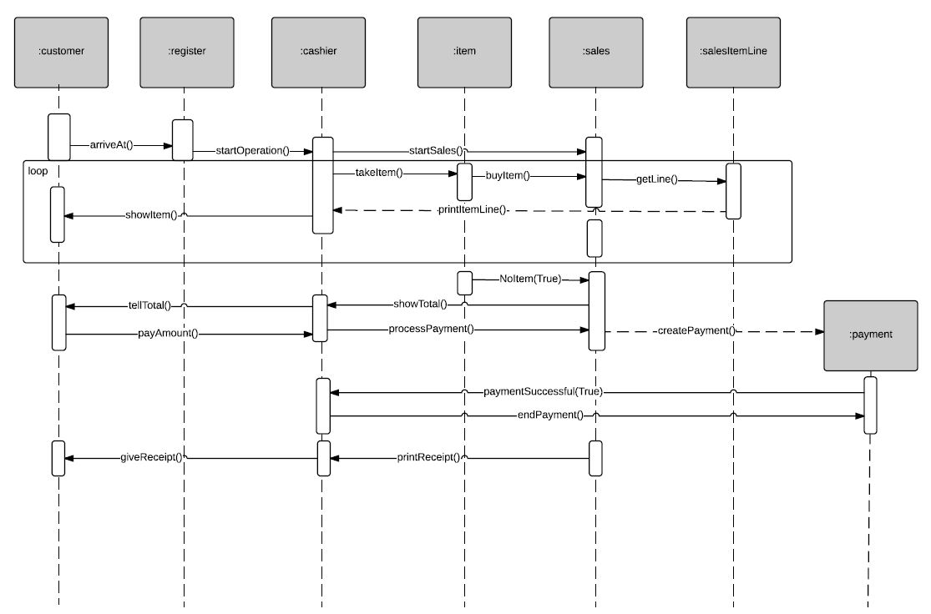

Use case view -- Process Sale

Slide 5
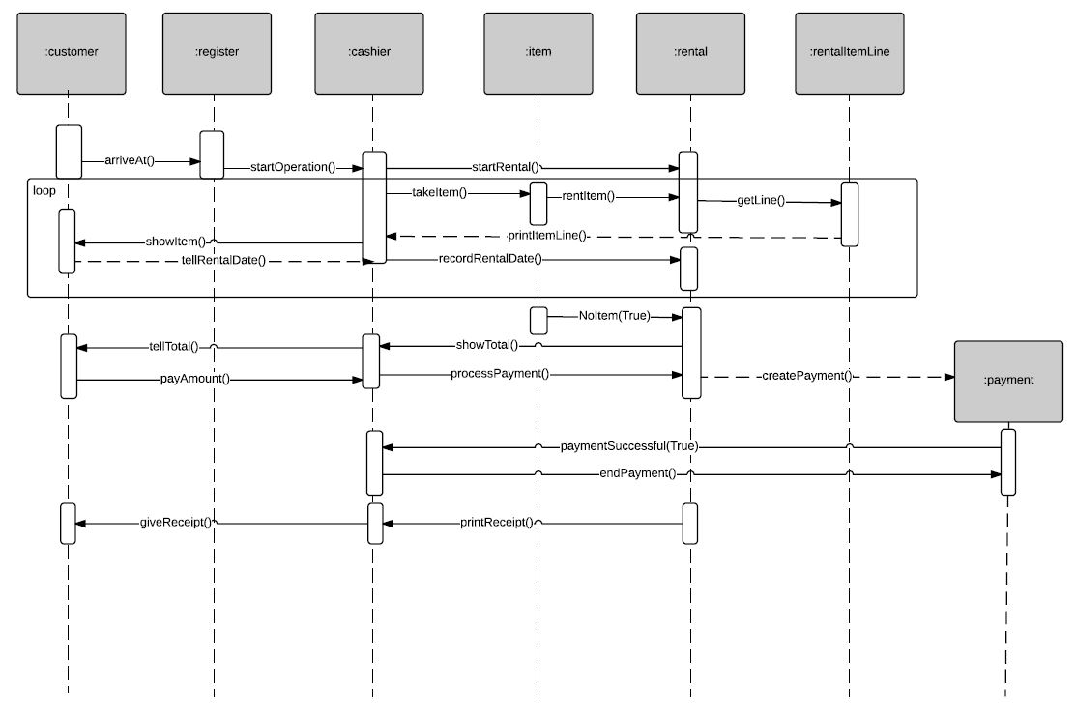
Use case view -- Process Rental

Slide 6
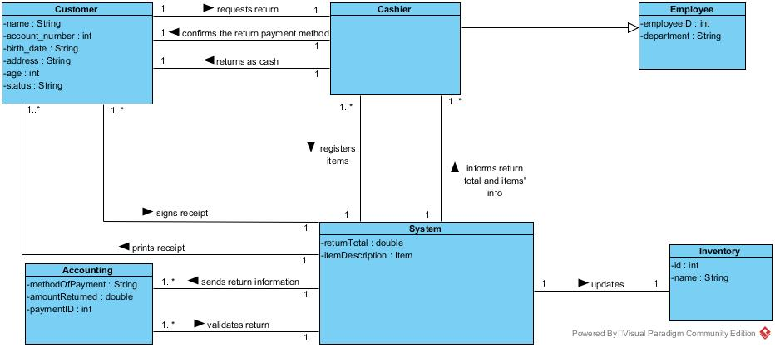
Use case view -- Handle Return

Slide 7
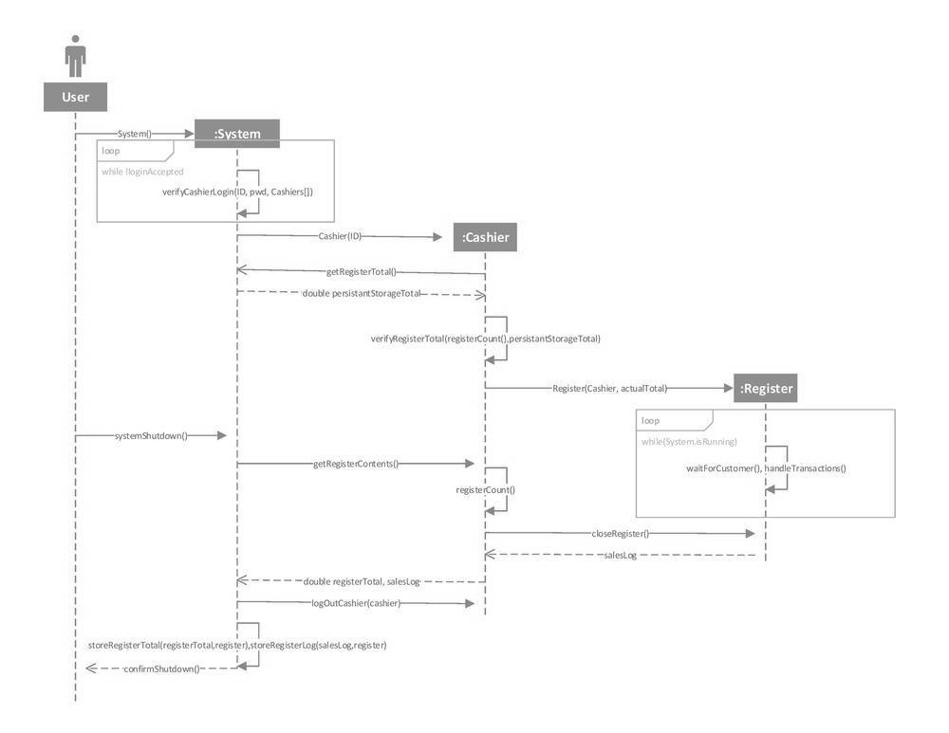
Use case view -- System Startup and Shutdown

Slide 8
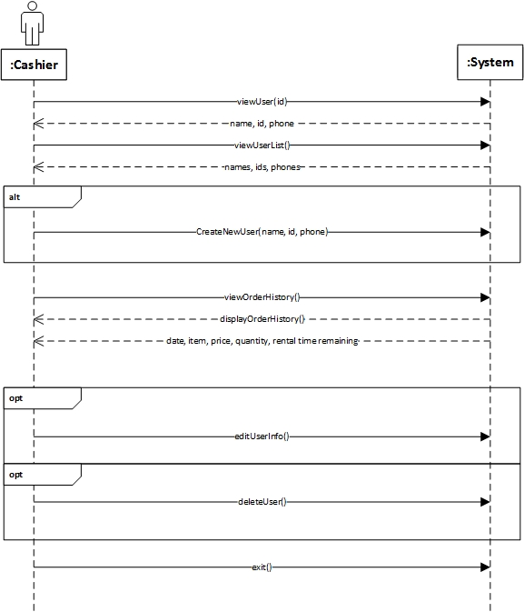
Use case view -- User Management

Slide 9
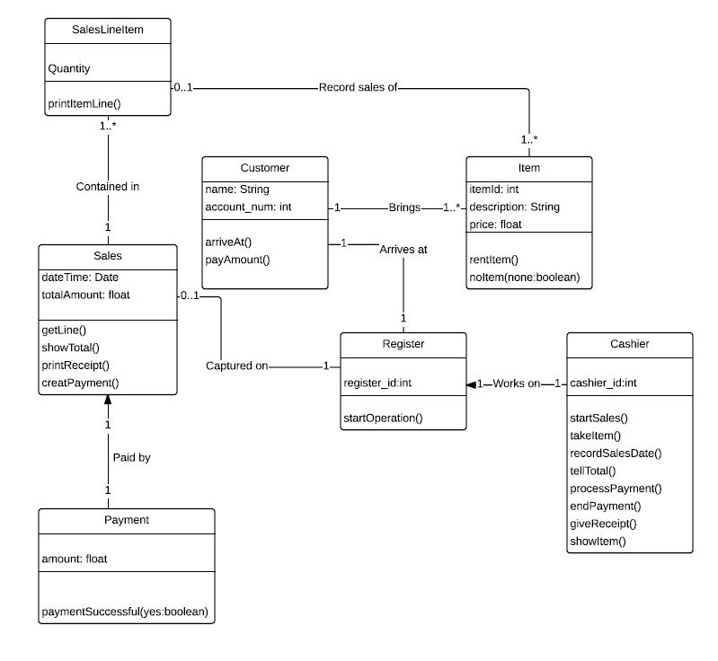
Class Diagram -- Process Sale

Slide 10
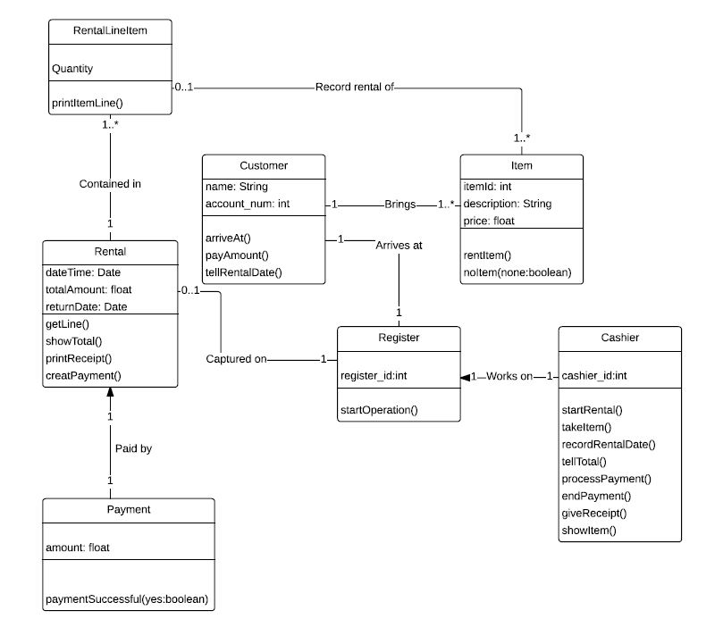
Class Diagram -- Process Rental

Slide 11
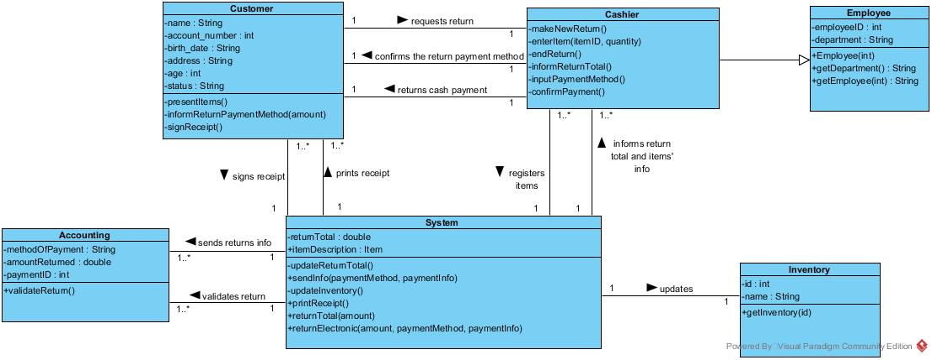
Class Diagram -- Handle Return

Slide 12
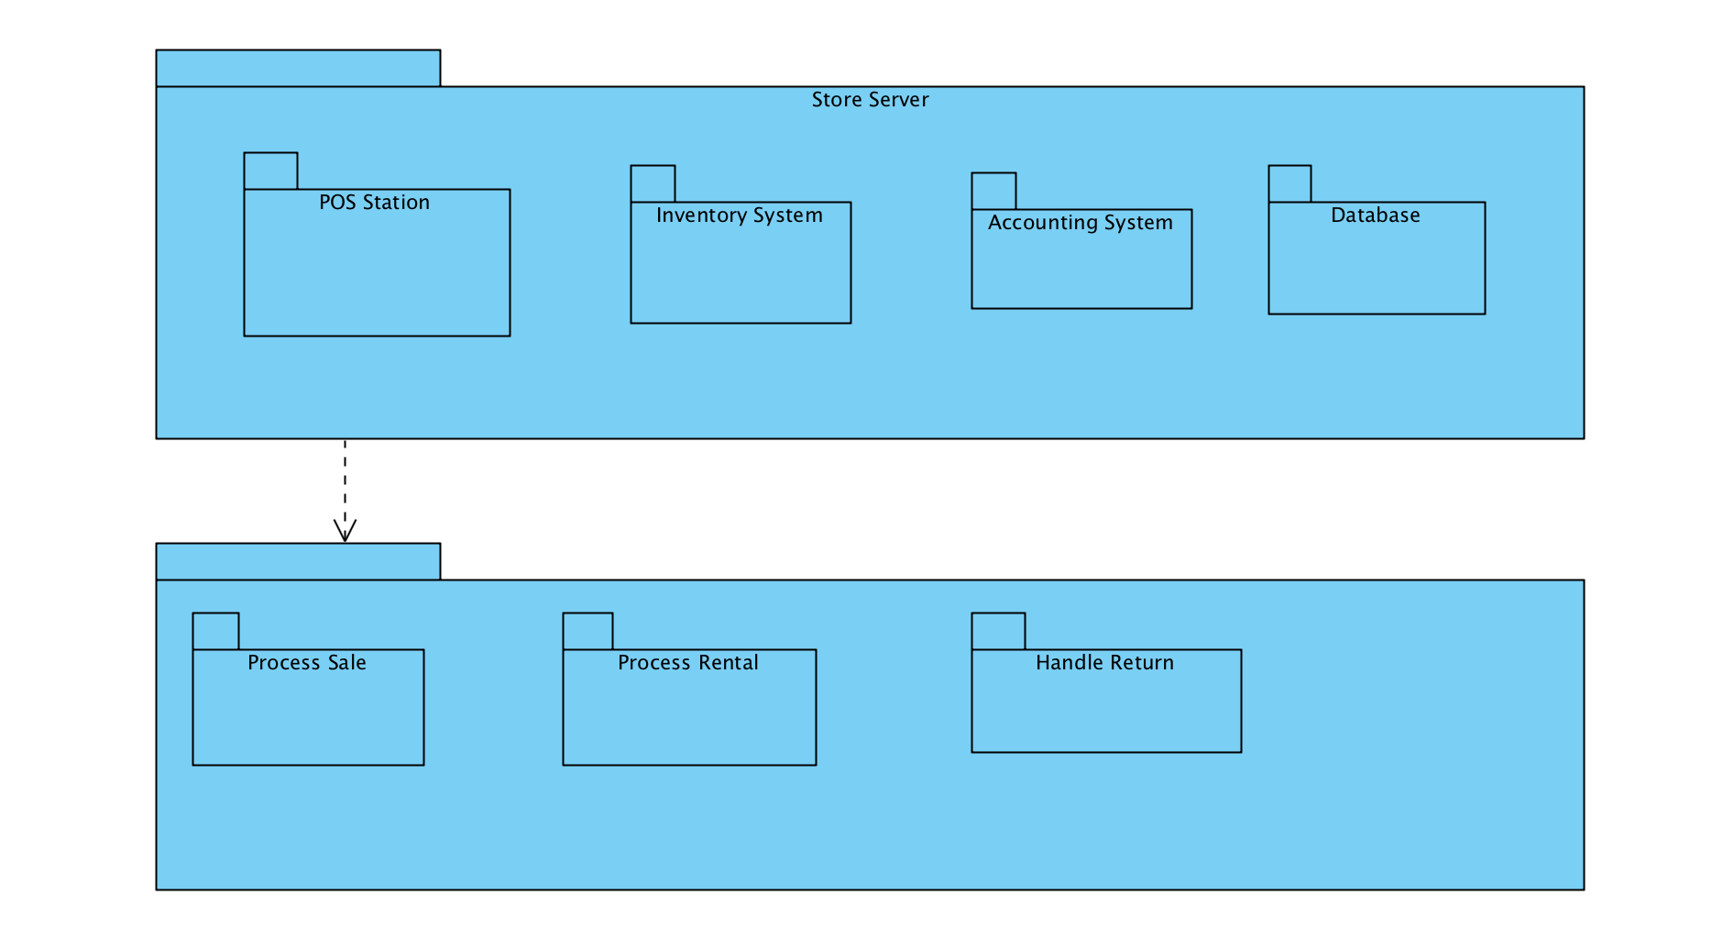
Package diagram

Slide 13
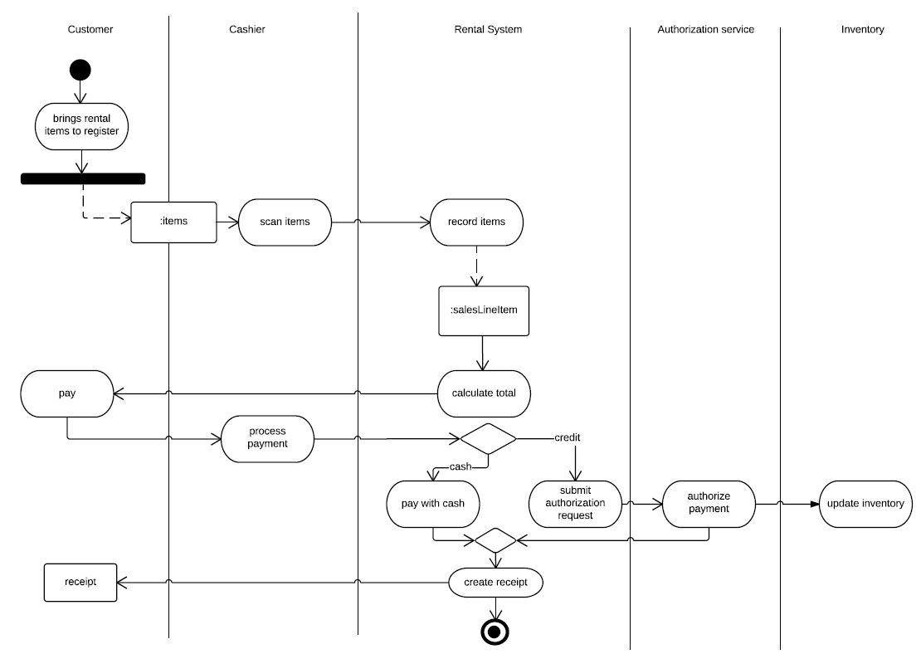
Data view for process sale

Slide 14
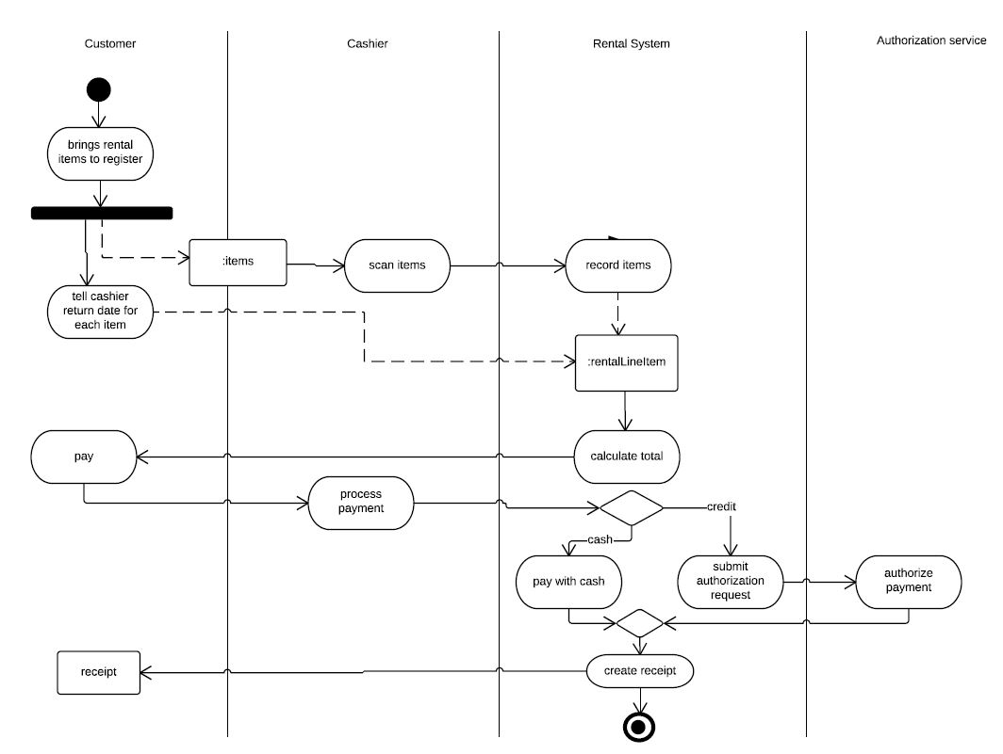
Data view for process rental

Slide 15
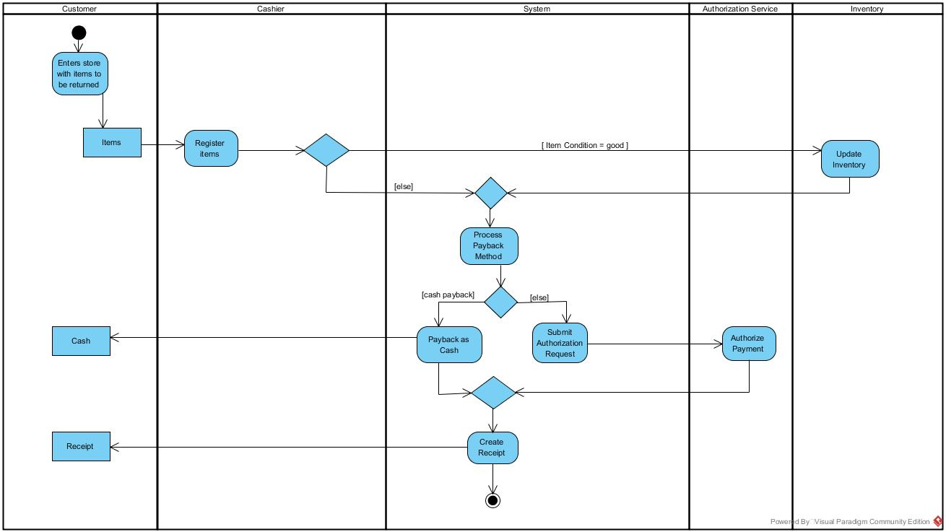
Data view for handle return

Slide 16
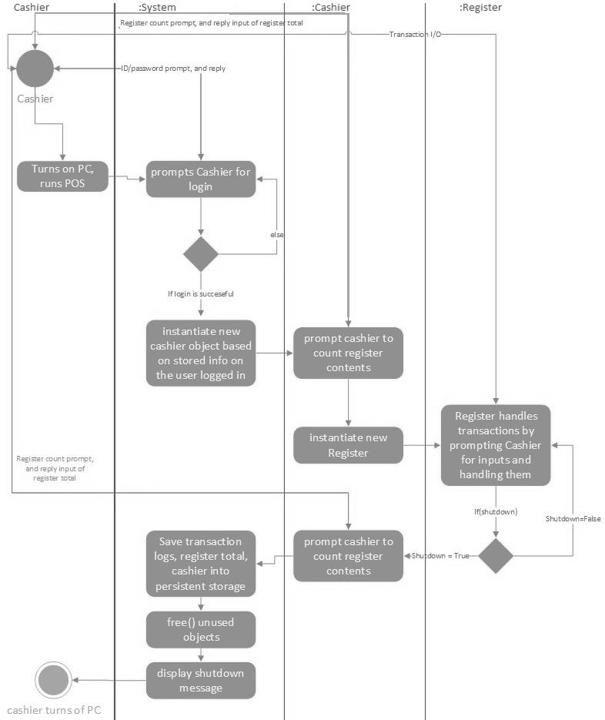
Data View for System Startup and Shutdown

Slide 17
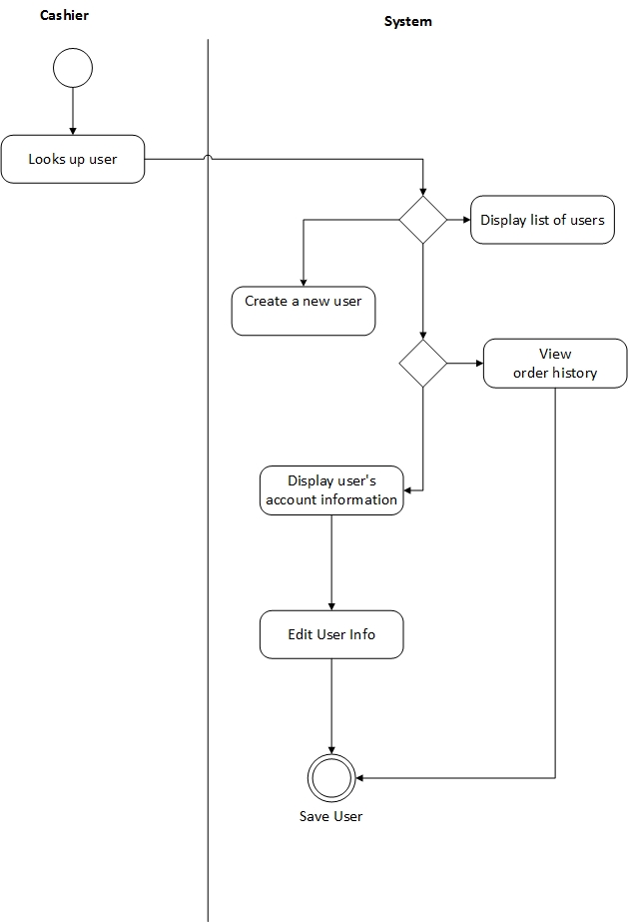
Data view for system user management

Slide 18
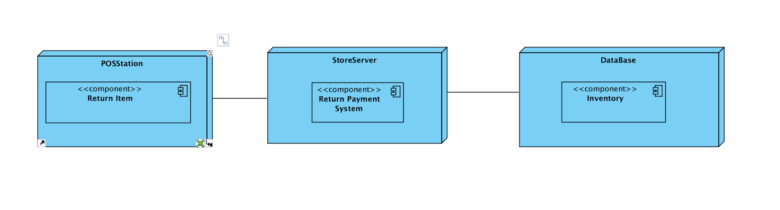
Deployment Diagram

Slide 19
Lessons Learned
Learned to draw a variety of software engineering diagrams
Better understanding of architectural views
Improved Java coding skills such as exception handling
Group collaboration
Document formatting
Effectiveness of making WBS and RM

